Slide 1
Tessellations
Recognizing shapes
Reflection
Tessellate hexagon
Tessellation by color
Identify
Patterns
Rhombus
Expand knowledge
Daily life tessellating shapes
3 Rhombi to hexagon
Create a pattern same shapes
Identify
Symmetry
Learn
Vocabulary

Slide 2
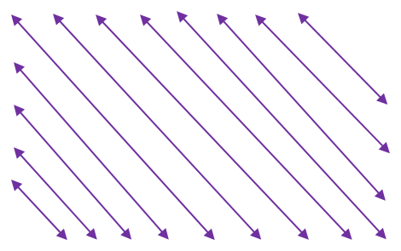
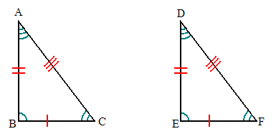
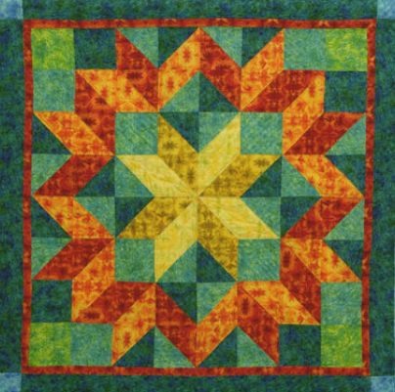
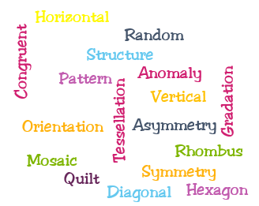
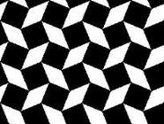
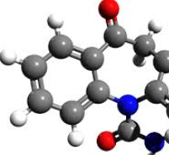
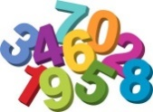
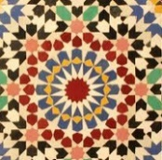
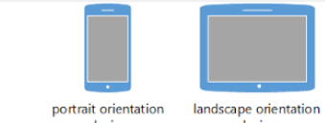
Learn Vocabulary

Slide 3
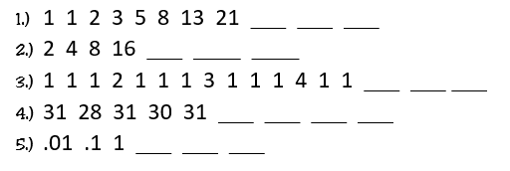
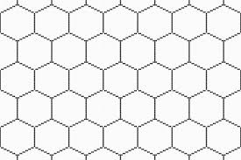
Identifying Patterns

Slide 4
Anomaly
Anomalies
A, B, C, D, E, F, G, H, 7, J, K, L, M, N, O, P, Q, R, S, T, U, V, W, X, Y, Z

Slide 5
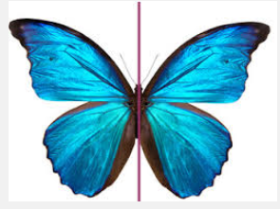
Identify Symmetry
Line of symmetry

Slide 7
A B C D E

Slide 8
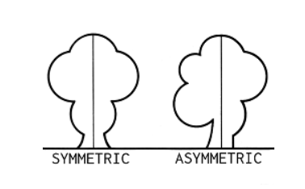
Asymmetry

Slide 9
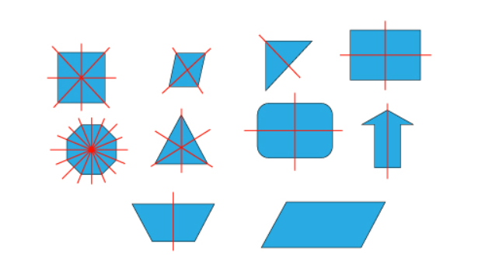

Slide 10
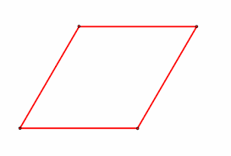
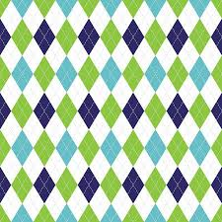
Rhombi

Slide 11
3 Rhombi to hexagon

Slide 12
Tessellate hexagon

Slide 13
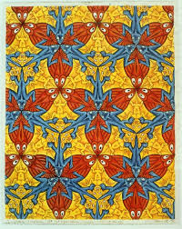
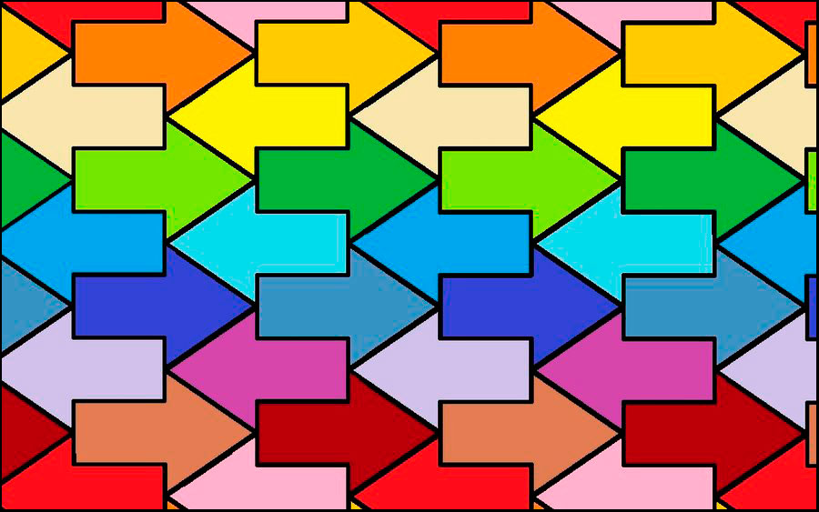
Tessellation by color

Slide 14
Create a pattern same shapes

Slide 15
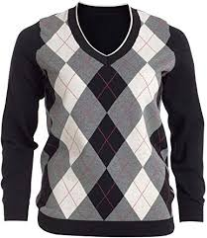
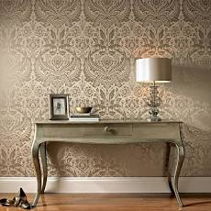
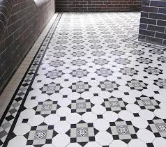
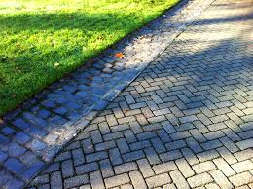
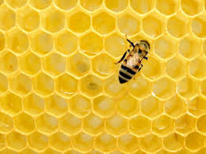
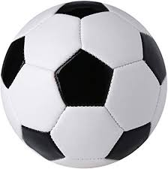
Daily life tessellating shapes

Slide 16
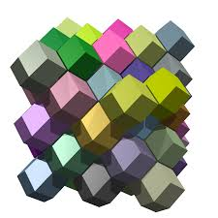
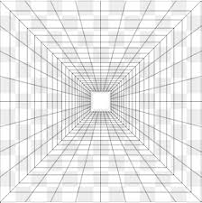
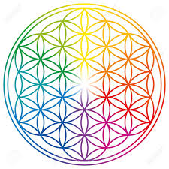
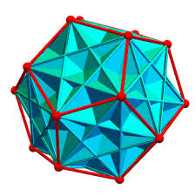
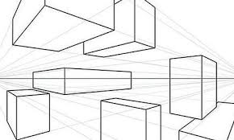
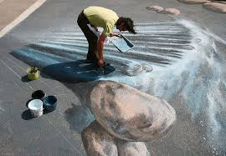
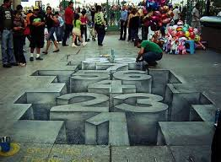
Recognizing Shapes
Recognize shapes from different perspectives and orientations,

Slide 17
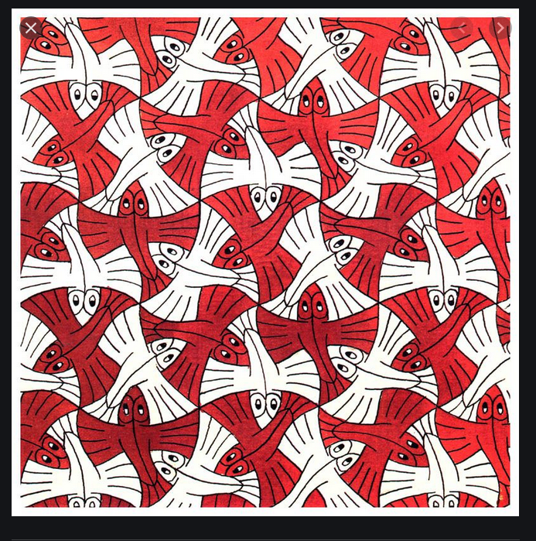
Math and Art
MC Escher

Slide 18
Reflection
Do you see any optical illusions (that is, things that look 3-dimensional)?
Does use of gradations in how the colors are organized cause your eyes to move across the tessellation?
What symmetries do you see in the tessellations?
What contributes to some asymmetry in the tessellation?

