Slide 1
Percent of Something
Basics Review
Edstar Analytics, Inc.

Slide 2
Fraction of Something
One whole is divided in equal parts.
Key: What is the “whole”?
4
6
2
2
2
3
7
8
3
4
Notes:
Do you see a pattern to our place value system? First we have the one’s place, then the tens, hundreds, etc. Describe the pattern.

Slide 3
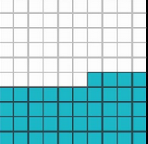
Percent of Something
The whole is divided into 100 pieces.
This is which is 44%.
44
100
Notes:
Do you see a pattern to our place value system? First we have the one’s place, then the tens, hundreds, etc. Describe the pattern.

Slide 4
Computing a Fractional Part
Half of something = ½ times the something.
Three fourths of something = ¾ times the something.
30% of something = 30% times the something.

Slide 5
How do you multiply 30%?
Change it to .30 or to 30/100.
30% of 80 = .30 x 80

Slide 6
Decimals
1/100 = .01
1/10 = .1
1 = 1
10 = 10
10 X 10 = 100
10 X 10 X 10 = 1,000
10 X 10 X 10 X 10 = 10,000
10 X 10 X 10 X 10 X 10 = 100,000
10 X 10 X 10 X 10 X 10 X 10 = ?
Notes:
Do you see a pattern to our place value system? First we have the one’s place, then the tens, hundreds, etc. Describe the pattern.

Slide 7
Ways to Write a Number
Standard form
1,346.45
Expanded form
1000 + 300 + 40 + 6 + +
4
10
5
100

Slide 8
Multiply by 1
Identity
1 x 6 = 6
1 x =
There are many ways to write 1:
4
4
24
24

Slide 9
Multiply by 1
Solve for missing part of a fraction
Multiply by 1 so that denominators match. Then the numerators have to match.
30
30
x
4
15
30
4
4
x
=
x

Slide 10
Multiply by 1
Solve for missing part of a fraction
Multiply by 1 so that denominators match. Then the numerators have to match.
x
4
15
30
=

Slide 11
Percent as Fraction or Decimal
Write as 2 decimal places
1 = 1.00 = 100%
= = 40%
4
10
40
100

Slide 12
Place Value
Sometimes the order of things matters,
h a t — t h a — a h t
And sometimes not.

Slide 13
When order matters
To sound out a word, you need to know where to start. (Left? Right? Middle?)
We start on the left and
proceed to the right.

Slide 14
Order Matters
live — evil — veil
256 — 562 — 652

Slide 15
Place Value
The order matters in our numbers because each place has a value.
thousands — hundreds — tens — ones

Slide 16
Read the Number
2031
2 thousands – 0 hundreds – 3 tens – 1 one

Slide 17
Zero
Zero plays the role of place holder
102 is not the same as 12

Slide 18
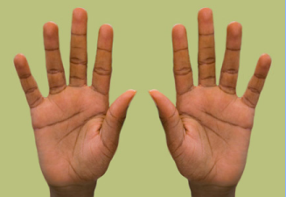
Digits
The symbols used to write the numbers
We use ten digits
0 | 1 | 2 | 3 | 4 | 5 | 6 | 7 | 8 | 9

Slide 19
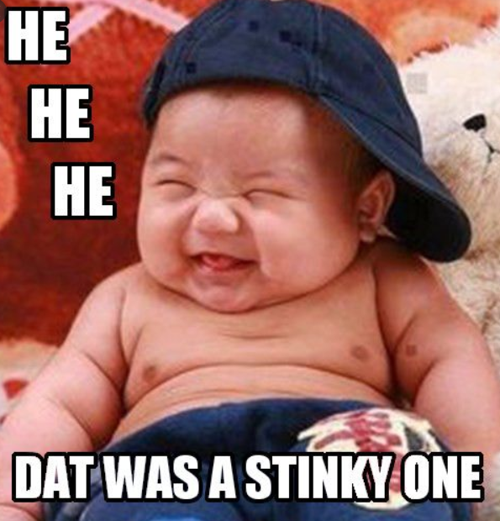
Joke Time!!

Slide 20
Base 10
Place Values
1 = 1
10 = 10
10 X 10 = 100
10 X 10 X 10 = 1,000
10 X 10 X 10 X 10 = 10,000
10 X 10 X 10 X 10 X 10 = 100,000
10 X 10 X 10 X 10 X 10 X 10 = 1,000,000
Notes:
20
Do you see a pattern to our place value system? First we have the one’s place, then the tens, hundreds, etc. Describe the pattern.

Slide 21
Looking Forward
Adding and Subtracting
You have to line up the place values for
borrowing and carrying
Numbers in other bases

Slide 22
Borrowing and Carrying
34 + 17 = ?

Slide 23
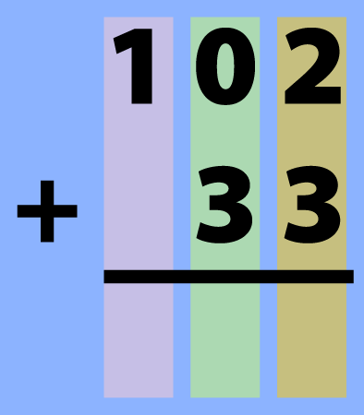
Line-up places
Note that the 1s place
has to line-up. Start there!

